Slide 1


AP Bio
Unit 8:
Ecology

Slide 2
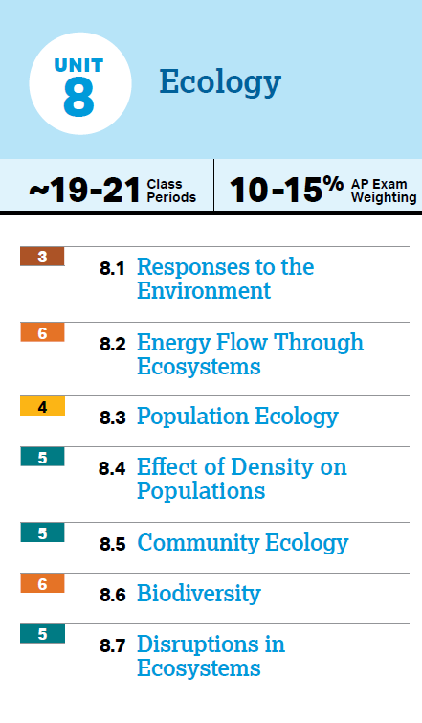
Unit 8: What You Need To Know
Organisms respond to their environment, help each other
Energy flows through trophic levels
Biogeochemical cycles
Exponential and logistic population growth
Density dependent and independent limiting factors
Simpson’s Diversity Index
Community interactions
Biodiversity and Keystone species
Ecosystems are disrupted due to human activity and natural events

Slide 3
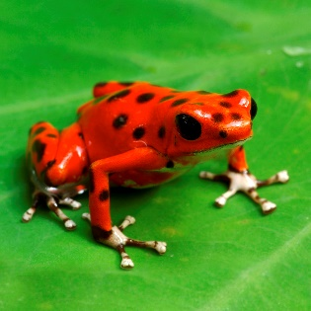
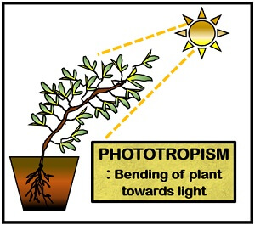
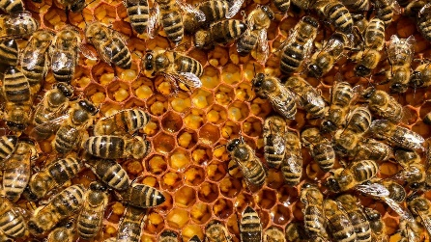
Response (8.1)
Organisms respond to their environment through behavioral and physiological changes
Taxis and kinesis
Phototropism
Organisms communicate using signals (stimulus that changes behavior) to establish dominance, find food, establish territory, ensure reproduction
Visual – warning colors, attraction for mating
Audible – mating songs
Tactile – herd interactions
Electrical – prey detection
Chemical – pheromones
Notes:
Behavior – what an organism does and how it does it – a result of genetic + environmental factors, can change
Physiological change – change in body’s structure/function
Taxis and kinesis are two types of animal movement in response to stimuli, but they differ in how the movement is directed. Taxis is a directed movement towards or away from a stimulus, while kinesis is a non-directional change in speed or turning rate in response to a stimulus

Slide 4
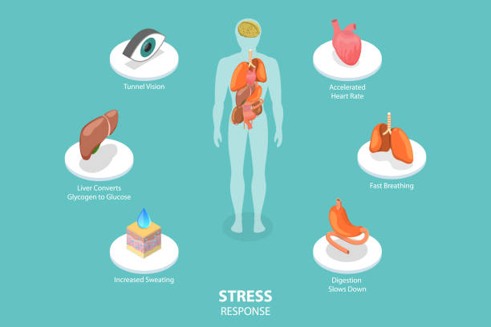
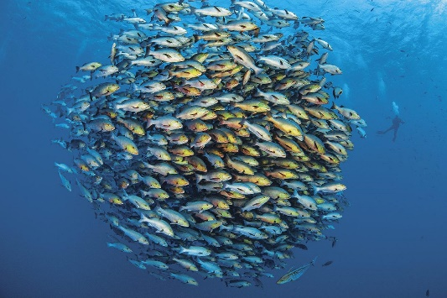
Behaviors (8.1)
Innate behaviors – developmentally fixed, inherited and unlearned (reflex)
Flight or fight response
Learned behaviors – behaviors modified based on specific experiences (imprinting, conditioning)
Fitness favors behaviors that increase survival and reproductive success
Cooperative behaviors tend to increase the fitness of both the organism and the population
Altruism – reduce individual fitness but increase the fitness of others (warning calls)
Kin selection – providing aid that enables other close relatives to produce offspring
Herd, flock, schooling behavior

Slide 5
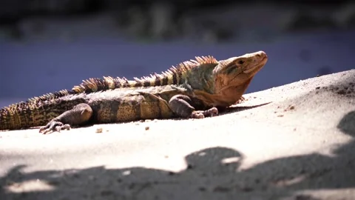
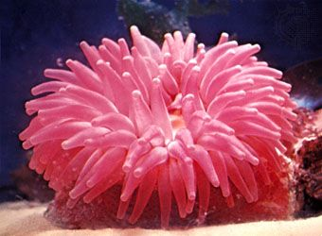
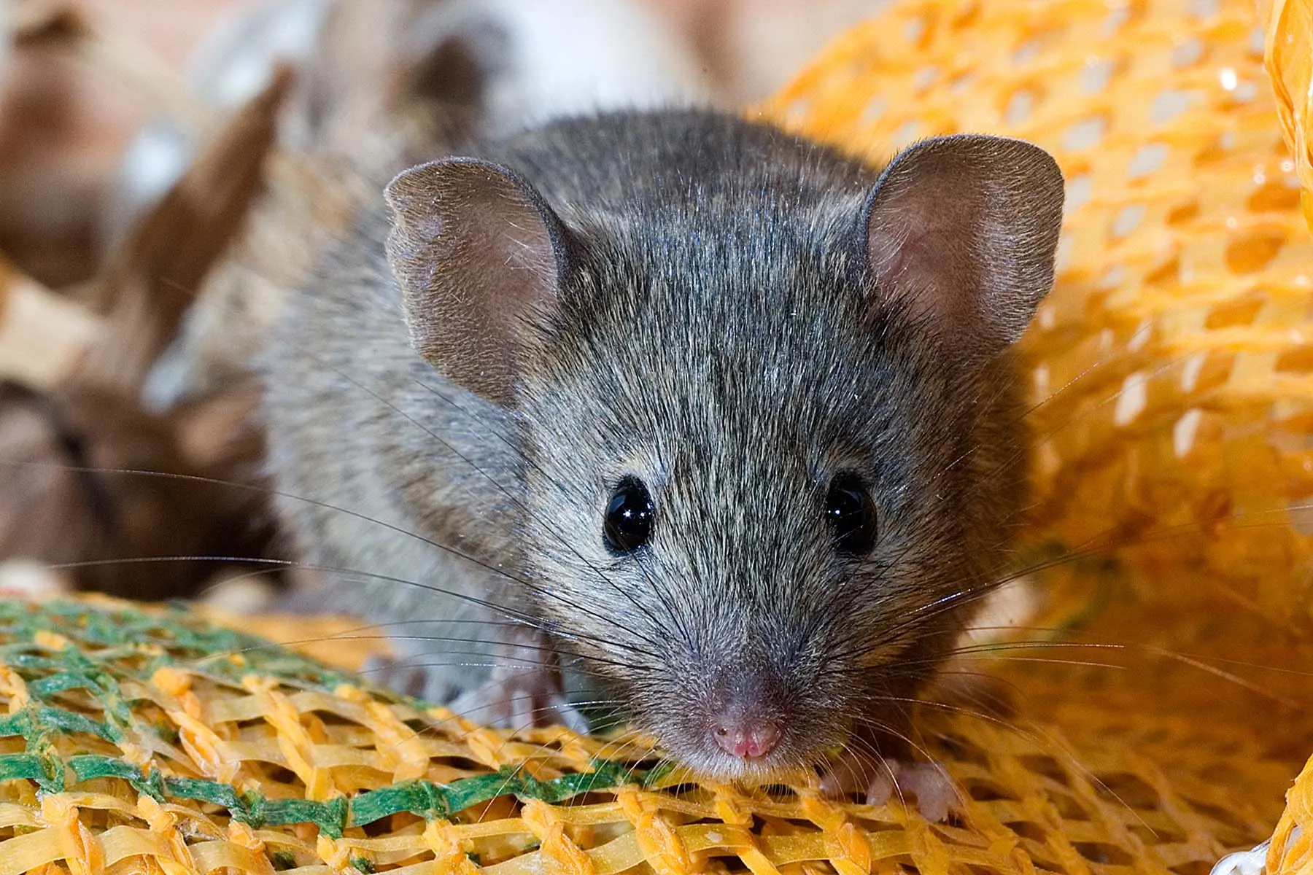
Organisms Need Energy (8.2)
To organize, grow, reproduce, maintain homeostasis – maintain a stable internal environment despite external changes
Thermoregulation – how animals maintain internal temperature
Endotherms – warmed by heat generated through metabolism – all chemical reactions of the body
Ectotherms – get heat from external sources
Net gain in energy = storage, growth, reproduction
Reproductive strategy can be different based on energy available – asexual/sexual, reproductive diapause
Net loss in energy = less reproduction, death
Metabolic rate – total energy used, smaller animals have higher

Slide 6
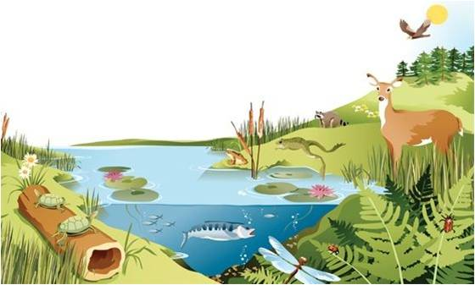
Energy Flows and Matter Cycles (8.2)
Populations -> Communities -> Ecosystems -> Biomes
Energy flows through ecosystems (both biotic and abiotic factors) between organisms – sourced from the sun
Matter and nutrients are cycled (biogeochemical cycles)
Contain abiotic and biotic reservoirs, and processes that cycle matter between reservoirs
Law of Conservation of Mass, Law of Conservation of Energy – cannot be created or destroyed, only transferred from one form to another

Slide 7
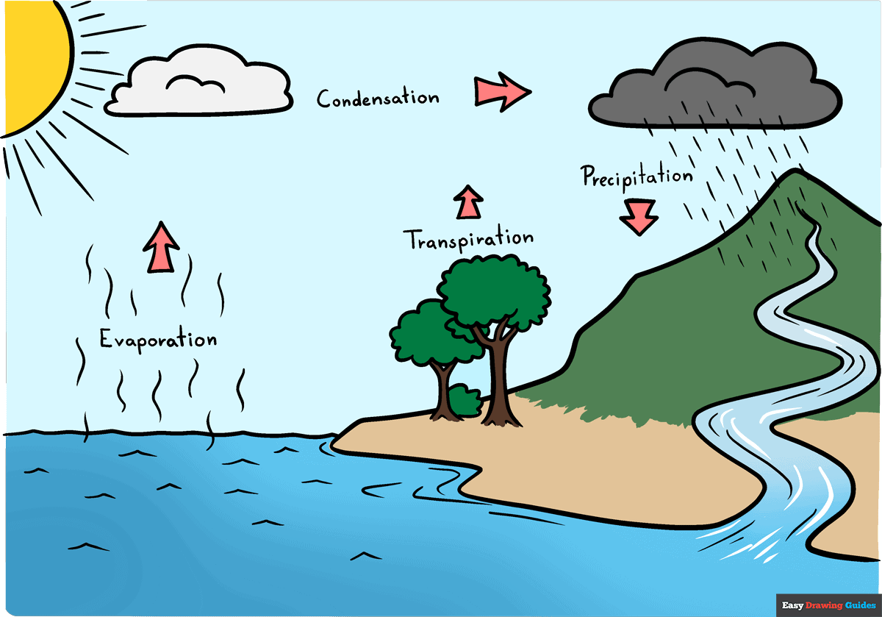

Biogeochemical Cycles: Water (8.2)
Hydrosphere – encompasses all water on Earth
Water evaporates from oceans and surface water, and transpires from plants -> condenses in atmosphere -> precipitates back to sources of water
Organisms intake water for survival and excrete it
Water
Hydrosphere
Oceans, surface water, atmosphere, organisms
Evaporation, Condensation, Precipitation, Transpiration

Slide 8
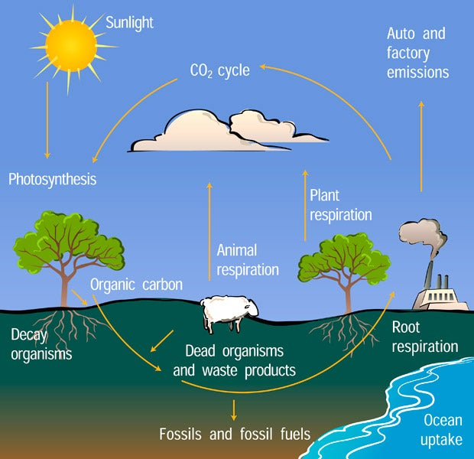
Biogeochemical Cycles: Carbon (8.2)
Carbon
Biosphere, Atmosphere
Carbohydrates in organisms, CO₂ in atmosphere
Photosynthesis, Cellular Respiration, Decomposition, Combustion
Transferred between atmosphere and biosphere – life between organisms (carbohydrates) and the atmosphere (carbon dioxide)
Turned into carbs by photosynthesis, released into atmosphere through cellular respiration, decomposition – dead organic matter broken down, releasing nutrients into environment, combustion – substance reacts with an oxidant, producing heat and light

Slide 9
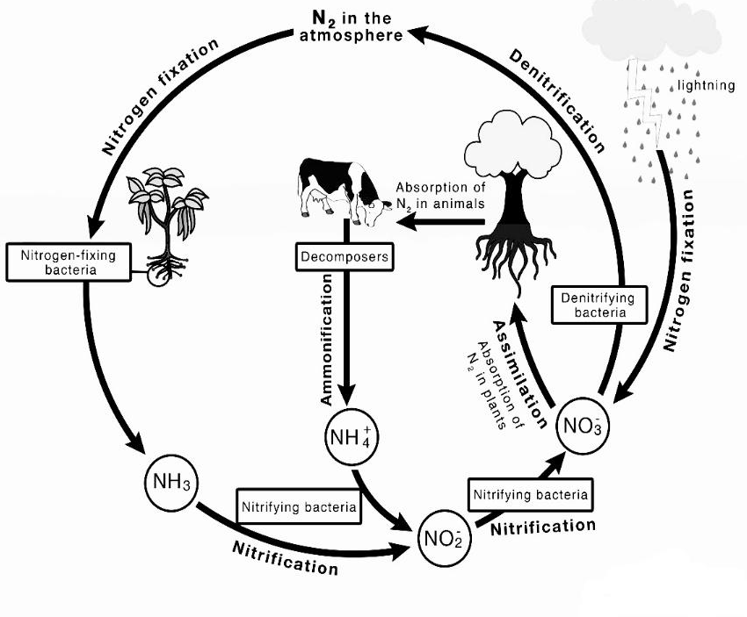
Biogeochemical Cycles: Nitrogen (8.2)
Largest reservoir is atmosphere
Certain bacteria in soil fix nitrogen gas (fixation) N₂ -> NH₃ – ammonia, becomes ammonium through soil (NH₄+)
Ammonia also converted to nitrates (nitrification)
Plants get nutrients and bacteria get compounds from the plant (assimilation)
When organisms die ammonia is released into soil (ammonification) and nitrates converted back to gas (denitrification) by bacteria
Nitrogen
Biosphere, Atmosphere
Most in atmosphere, when fixed N₂ becomes NO₃- and NH₃ by microorganisms in soil
Fixation, assimilation, ammonification, nitrification, denitrification

Slide 10
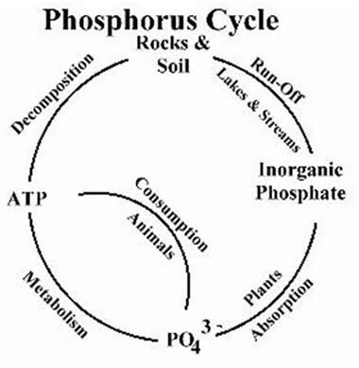
Biogeochemical Cycles: Phosphorus (8.2)
Weathering rocks release phosphate (PO₄³-) into soil and groundwater
Taken up by plants -> transferred to animals
Returns to the soil through decomposition and excretion
Phosphorus
Biosphere, Hydrosphere, Lithosphere
Rocks, soil and groundwater, plants, animals
Weathering, consumption, decomposition, excretion

Slide 11
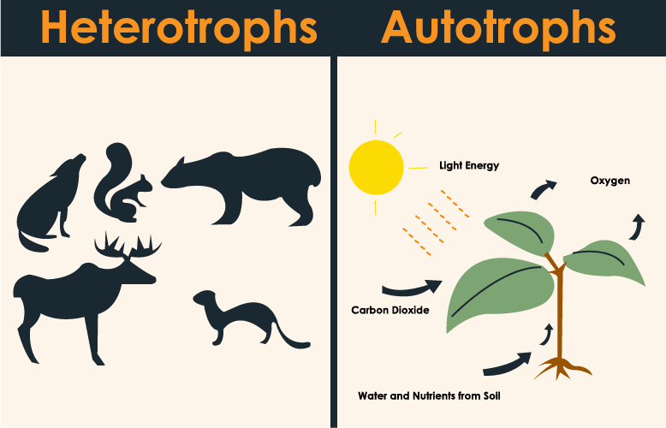
Autotrophs vs. Heterotrophs (8.2)
Autotrophs (producers) – capture energy from environment
Photosynthetic – energy captured from the sun (plants, algae)
Chemosynthetic – energy from inorganic molecules, in the absence of oxygen, sunlight
Heterotrophs (consumers) – capture energy in carbon compounds by consuming energy from organic matter in autotrophs
Metabolize carbohydrates, proteins, lipids for energy
Herbivores, omnivores, carnivores, decomposers, scavengers

Slide 12
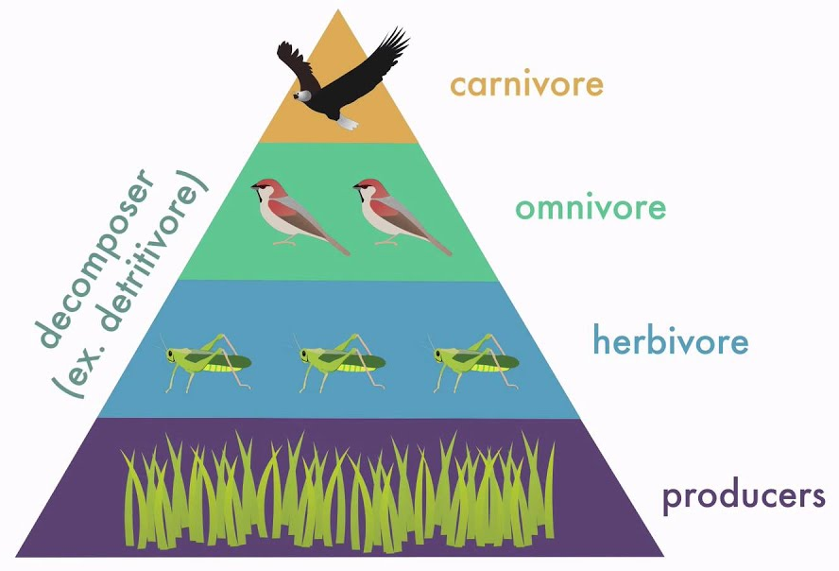
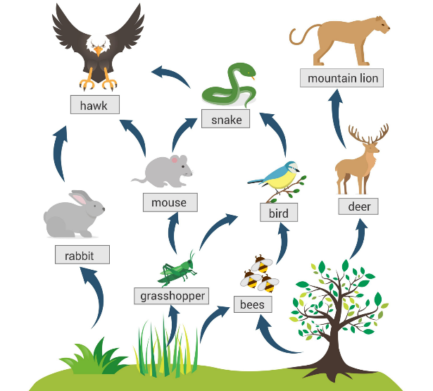
Trophic Levels (8.2)
Energy flows through trophic levels (levels in a food web) from producers to primary, secondary, and tertiary consumers
10% rule – rest lost as heat
A change in the number of producers and sunlight can affect the rest of the trophic levels
Food web – shows energy relationships between organisms in an ecosystem

Slide 13
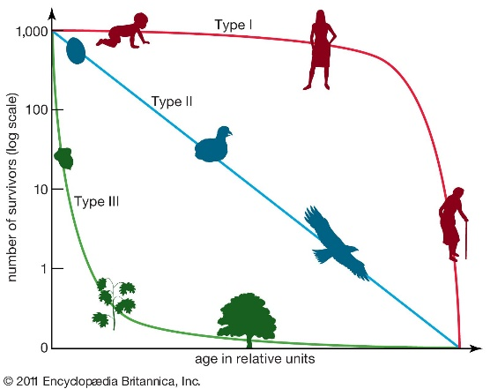
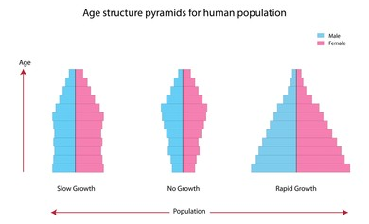
Populations and Demographics (8.3)
Population – group of individuals of a single species living in the same general area
Population ecology – explores factors that influence size, density, distribution, and age structure of populations
Demographics:
Density - # of individuals per unit of volume – different dispersions (clumped, unform, random)
Survivorship curves – rate of survival over time - Type I (long life), Type II (preyed upon), Type III (survivor curve)
Age-structure pyramids – relative # of individuals of each age in a population - Rate of population growth in relation to births/deaths

Slide 14
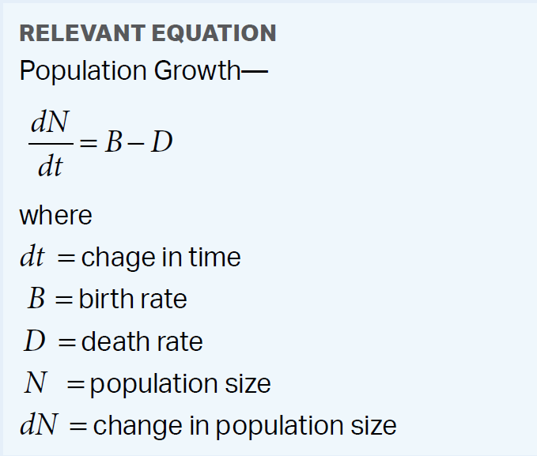
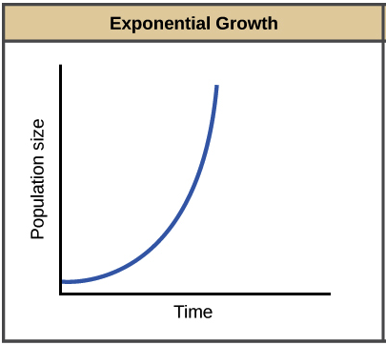
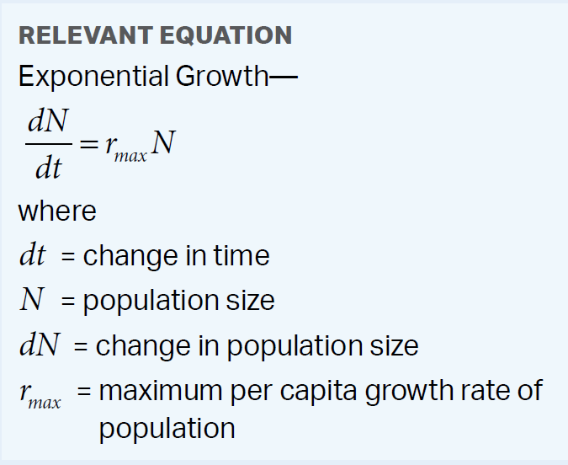
Population and Exponential Growth (8.3)
Population growth over time = individuals born – individuals died (usually measured in years)
Population grows when birth rate > death rate
Exponential growth – growth of a population under ideal conditions (abundant resources)
Exponential population growth = initial population * max growth rate
As pop. gets larger, grows faster
Find growth rate and pop after 1 gen
Initial Pop | Births | Deaths | Rate
500 | 100 | 40 | 0.12

Slide 15
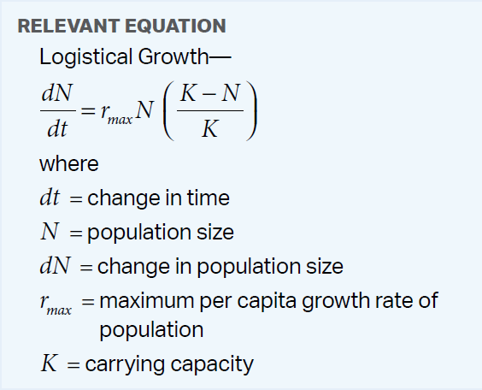
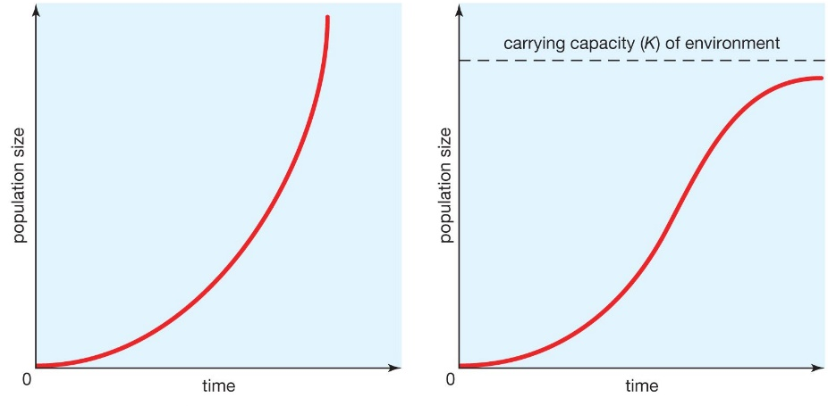
Carrying Capacity and Logistic Growth (8.4)
Exponential population growth is unlimited – resources are abundant
Not possible for a long time
Carrying capacity – the maximum population size that a certain environment can support at a particular time -> logistic population growth – rate of growth declines as carrying capacity is reached
Affects reproduction (life history)
Ex. R= 1.0, Pop. = 1300, K = 1600
Notes:
+ 243.75
Life history is when it reproduces, how many times, how many children each time

Slide 16
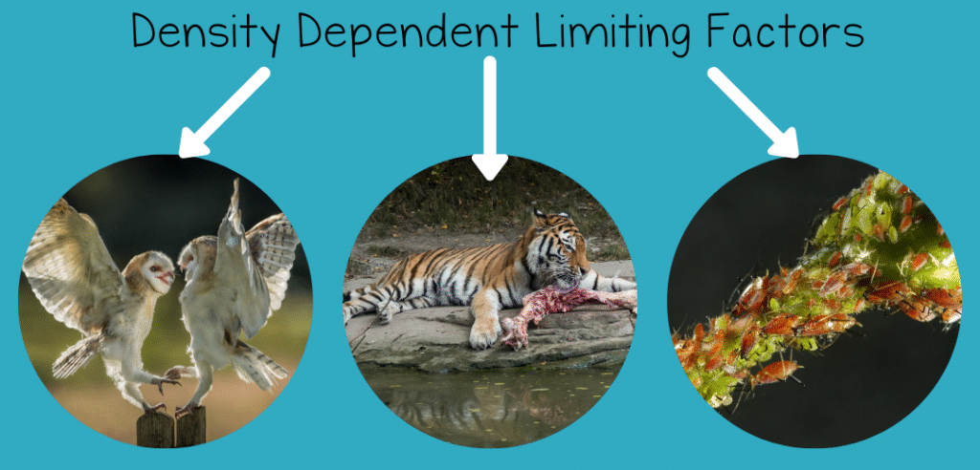
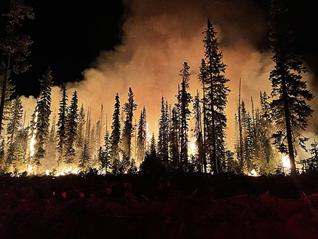
Density Dependent and Independent Factors (8.4)
Density dependent factors – when there is a higher population density (individuals per unit of area) death rate increases/birth rate decreases
Competition for resources – food, space
Territoriality – nesting
Disease – easier transmission
Predation – easier to find prey
When population gets too high, these factors will cause it to shrink
Density independent factors – death rate changing regardless of a change in population density
Natural disasters
Human involvement

Slide 17
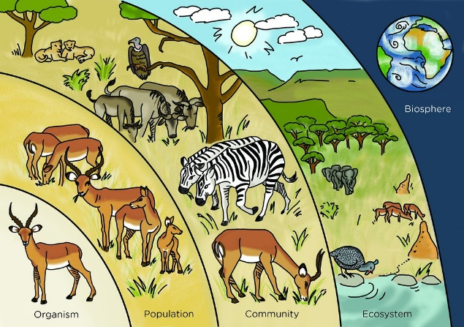
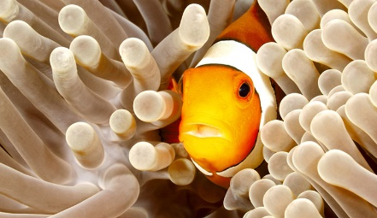
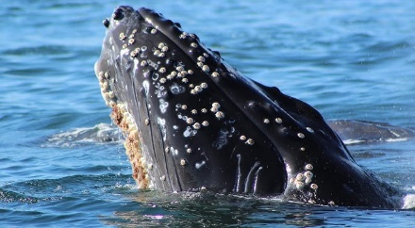
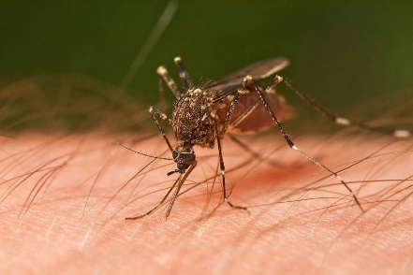
Community Ecology (8.5)
Community – a group of populations of different species living close enough to each other to interact
Interspecific interaction can be positive for a species, negative for a species, or neutral – cause community to change over time
Interactions determine how each species accesses energy and resources
Symbiosis – close and long-term relationship between 2 species
Parasitism (+/-) – one species (parasite) gets nourishment from the host, which is harmed in the process
Mutualism (+/+) – both species benefit from the relationship
Commensalism (+/0) – interaction that helps one species but neutrally affects the other
Notes:
Clownfish find shelter and protection within the stinging tentacles of the anemone, while the anemone benefits from the clownfish's presence by being cleaned of parasites and attracting prey
Barnacles get food and ride, no detriment to whale
Mosquito takes our blood and leaves disease or itchiness

Slide 18
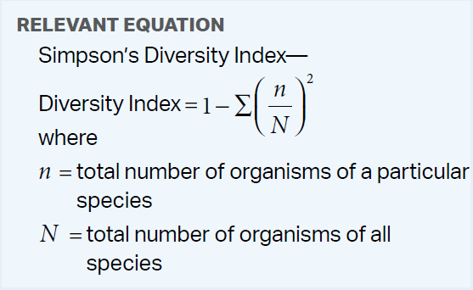
Simpson’s Diversity Index (8.5)
Measure diversity using Simpson’s Diversity Index
Organisms in a species/by all organisms
Square and add up all of these values
Subtract from 1
Accounts for species richness - # of species
And relative abundance - % each species makes up of the total community
More diverse = more stable, greater productivity
Find the diversity:
Species A | 10
Species B | 15
Species C | 35
Species D | 40
Notes:
More diverse = more species that have different niches = less competition
1-0.315=0.685

Slide 19
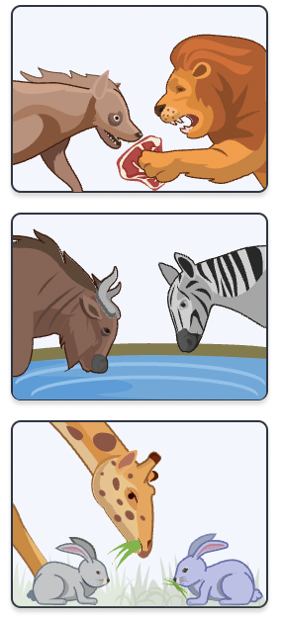
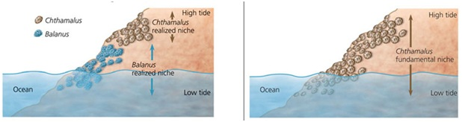
Competition and Niches (8.5)
Interspecific competition (-/-) – competition between 2 species when resources are in short supply
Less reproductively advantaged species may be eliminated (competitive exclusion)
Ecological niche – sum of biotic/abiotic resources a species uses
Has both fundamental and realized niche
Natural selection favors behaviors that lesson competition -> niche partitioning (move to realized nice) – similar species split up resources
Notes:
more species (more diversity) that have different niches = less competition

Slide 20
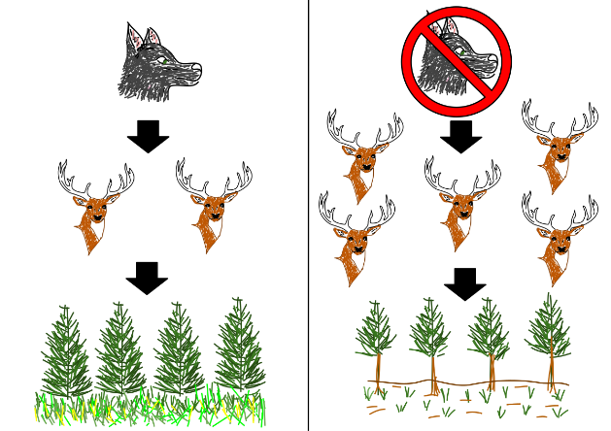
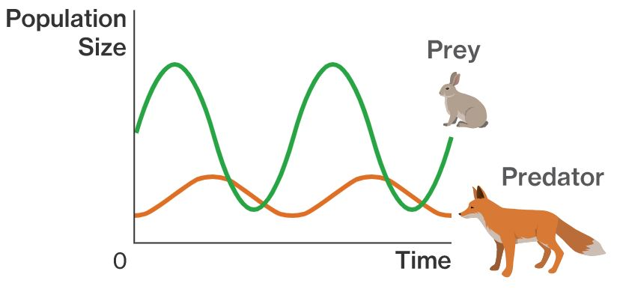
Predation and Trophic Cascades (8.5)
Predation (+/-) – one species kills and eats the other (predator and prey)
Herbivory (+/-) – organism eats plant
Prey has developed adaptations – camouflage, warning color, mimicry
Predator-prey cycles – regulate size of both species
Trophic cascade – changes in one level of a food web can affect other levels
Notes:
Food web = energy relationships

Slide 21
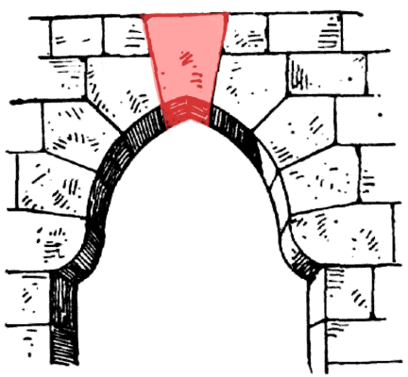
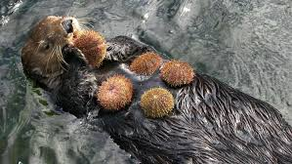
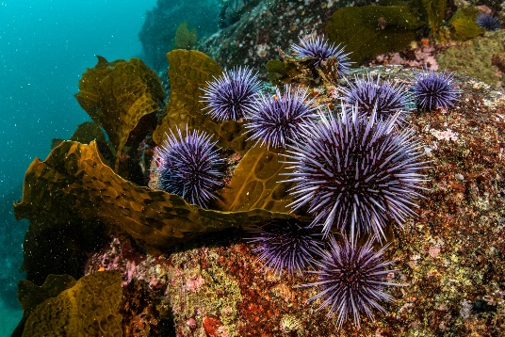
Biodiversity (8.6)
Biodiversity – the variety of living things and life processes within a population (group of a species), community (multiple species), or ecosystem (abiotic + biotic factors)
More diversity = more resilience, can adapt to changes
Key elements of an ecosystem:
Vital abiotic factors
Producers – without them no energy to higher trophic levels
Dominant species – are the most abundant in a community – as a result can often exhibit resilience when the environment changes (more variation within the species)
Keystone species – not abundant, but exerts control over the community structure due to its niche - when removed, the community collapses

Slide 22
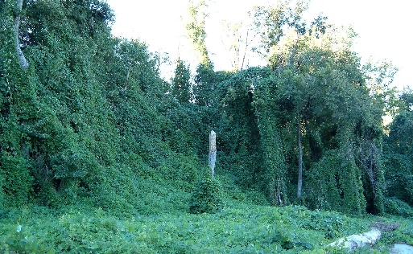
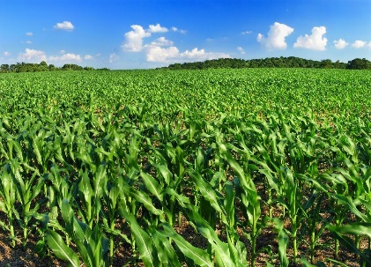
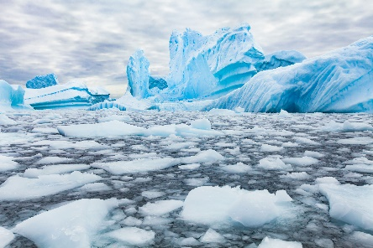
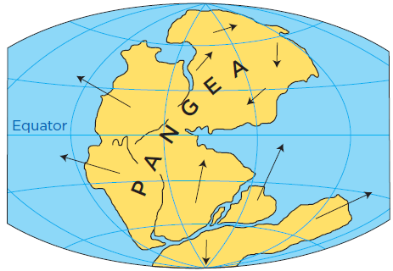
Dangers to Ecosystems (8.7)
Organisms are generally well adapted to their environments but can be at risk if the environment suddenly changes
Dangers to ecosystems:
Invasive species - non-native species that, when introduced to a new environment usually cause harm to the environment - exploit new niche
Global climate change – change in the global climate (warming), largely due to human activity –> weather and habitat changes
Geological and meteorological events (El Nino, Continental Drift, meteor impact on dinosaurs)
Habitat loss – habitats are destroyed (logging, urbanization, monocropping, habitat fragmentation)
Notes:
Invasive species outcompete, no predators
Kudzu, scientifically known as Pueraria montana, is a fast-growing, invasive vine native to East Asia, and has become a significant problem in the Southeastern United States. It was introduced to the US in the late 19th century for erosion control and as a forage crop, but its rapid growth and ability to smother other vegetation have made it a major ecological and agricultural pest.
Explain greenhouse gases
El nino is periodic weather change, continental drift moves ecosystems from og environment
Monocropping = low diversity

Slide 23
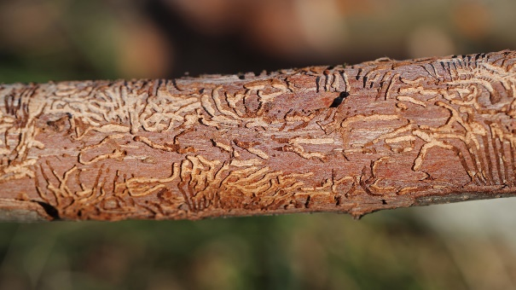
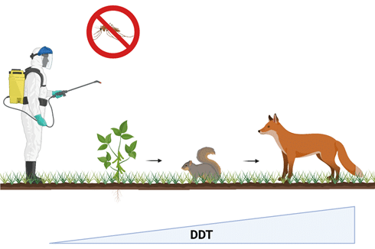
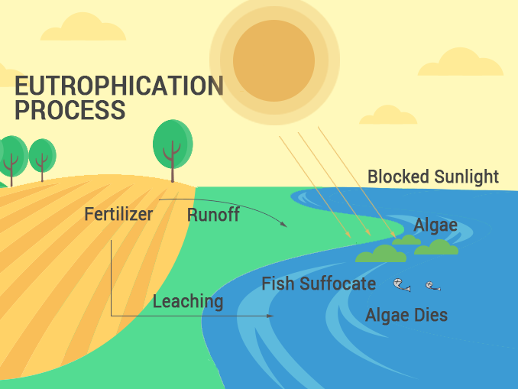
Extinction (8.7)
Human activities can cause extinction and disrupt ecosystems
Transmission of infection across the Atlantic by humans has resulted in Dutch Elm Disease in America and the Potato Blight in Europe
Biomagnification – toxins that cannot be broken down biologically become more concentrated in successive trophic levels (DDT)
Eutrophication - water bodies become excessively enriched with nutrients leading to harmful algal blooms and oxygen depletion, harming aquatic life (accelerated by agricultural runoff)

